Slide 2
AHA – Visual Computing

Slide 3

Mark
Horowitz
Stanford University
Notes:
John Kelly, Lisa Su, both will be presenting
Stories with people – compile a 100/day, FPGA a couple of times a day, ASIC, one a year, DOD once at decade.

Slide 4
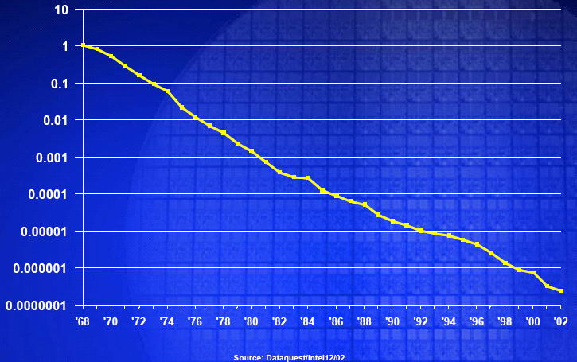
Scaling Provided A Great Ride
For a 2x scaling
Get 4x more gates,
Gates get 2x faster,
Energy decrease 8x
Dennard, JSSC,
pp. 256-268, Oct. 1974
No Exponential is Forever...but We Can Delay 'Forever‘, Moore ISSCC 2002

Slide 5
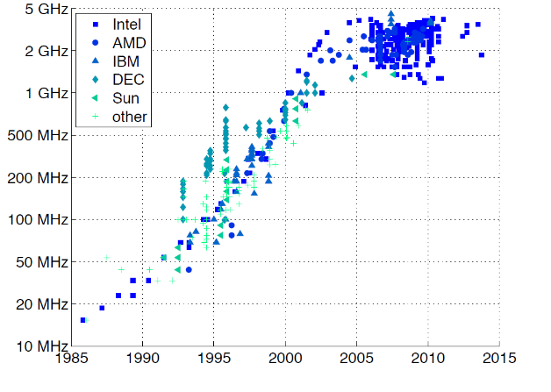
Houston, We Have A Problem
http://cpudb.stanford.edu/
Notes:
Label access

Slide 6
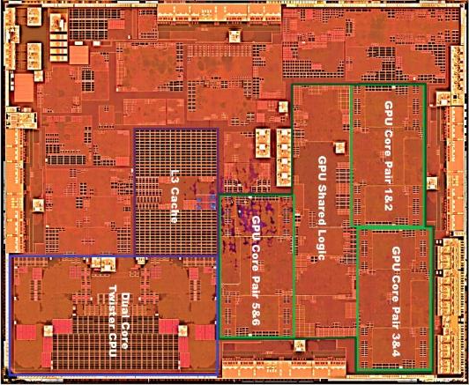
To Continue to Scale Performance
Apple’s A9 (2015)
https://www.anandtech.com/show/9686/the-apple-iphone-6s-and-iphone-6s-plus-review/3
Notes:
Need to highlight where the accelerators are

Slide 7
How To Create These Accelerators?
Study application

Slide 8
How To Create These Accelerators?
Study application
Design hardware
Add Verilog, or synC code here

Slide 9
How To Create These Accelerators?
Study application
Design hardware
Write software
Add C code here

Slide 10
Not so Secret Downside
$100M
Many Years

Slide 11

Not Surprising
It is a waterfall model of design!

Slide 12

Software Isn’t Built That Way
Moved away from that style decades ago
Enables small teams to build amazing apps

Slide 13
Agile Design
Rapidly iterate on end-to-end system
Learn about real problems, and goals

Slide 14
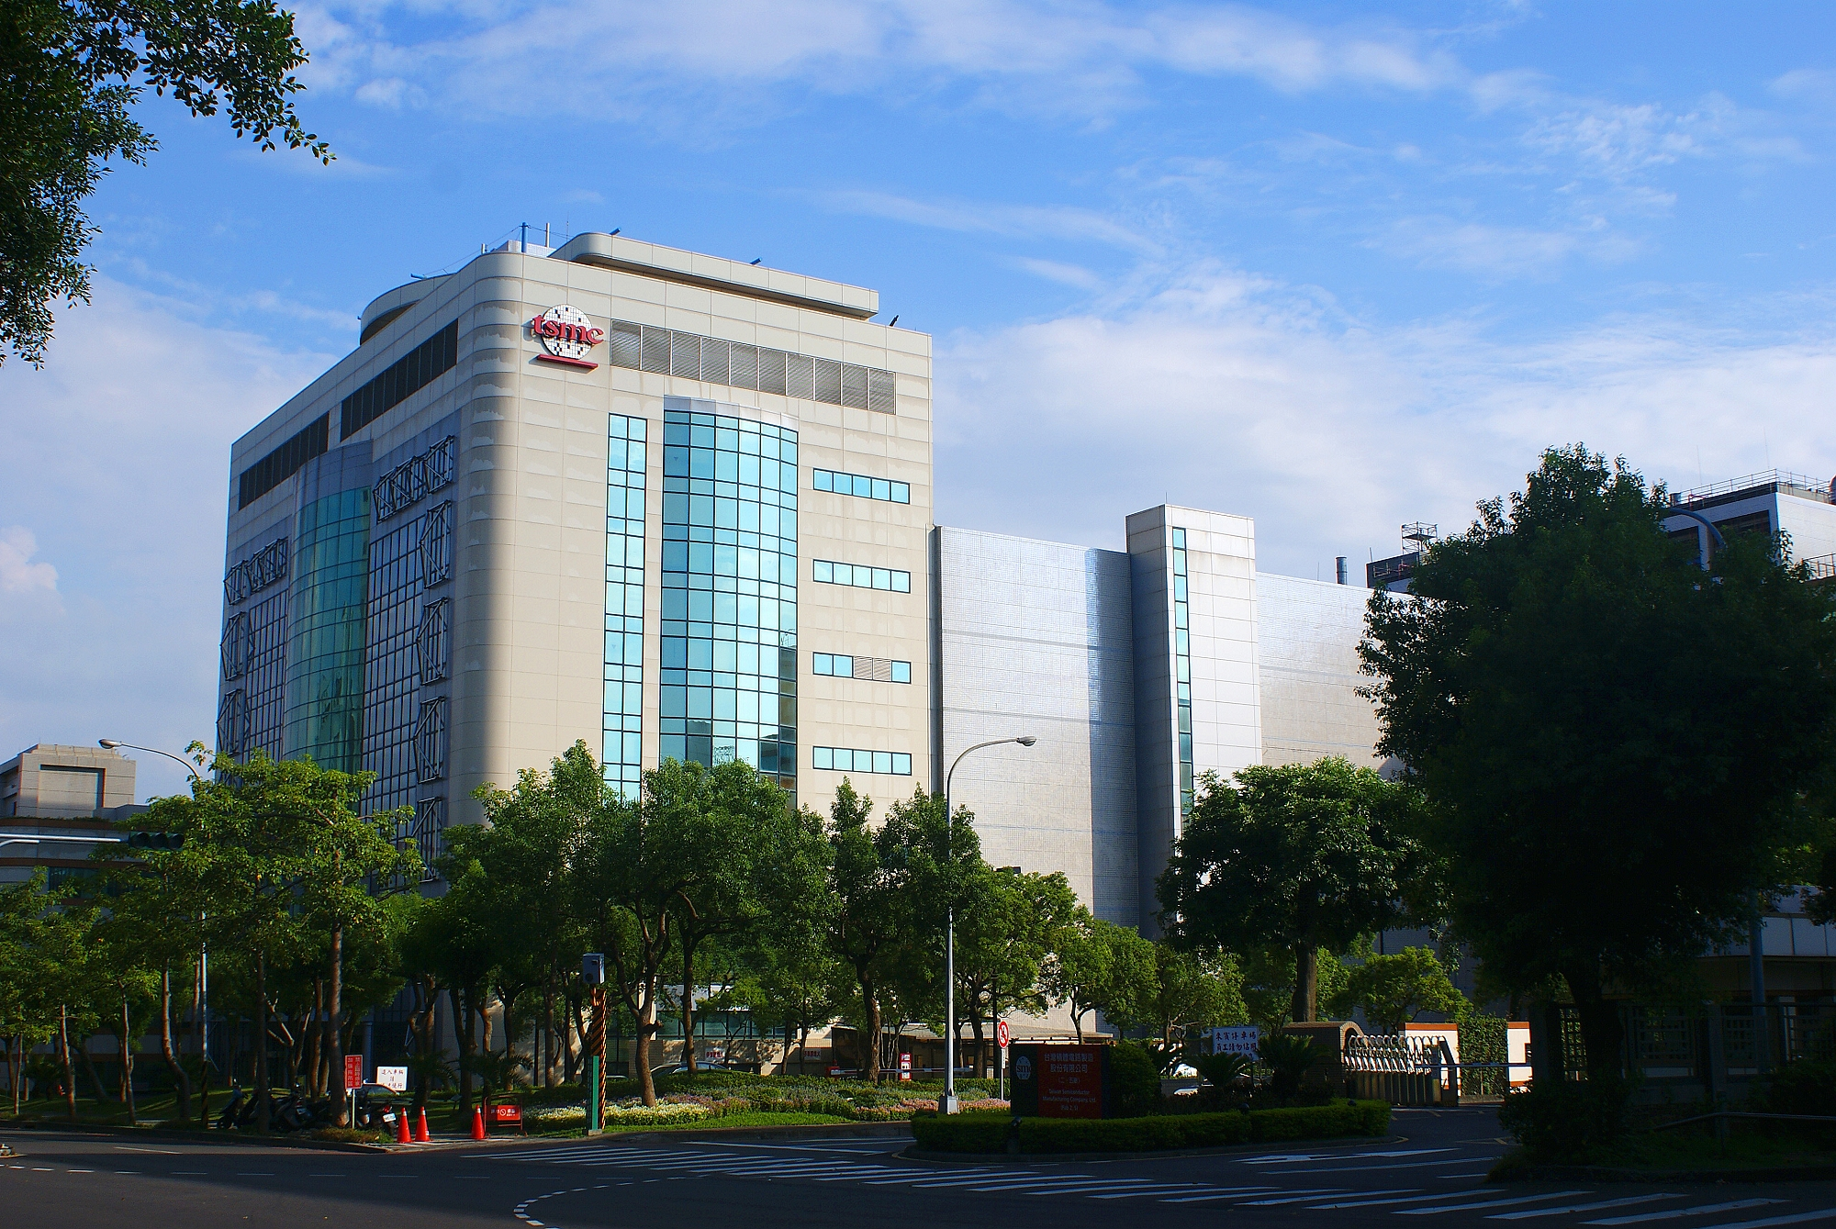
Can’t Apply This to Hardware, Right?
https://upload.wikimedia.org/wikipedia/commons/8/8a/TSMC_Fab5.JPG
Notes:
Need to have a better title?

Slide 15
AHA!
Agile Hardware

Slide 16
Agile Design
It is about reuse
It is about clean interfaces
It is about constructors, not instances
It is about productivity
Notes:
Do we need to prove this? How to get numbers to back this up.

Slide 17
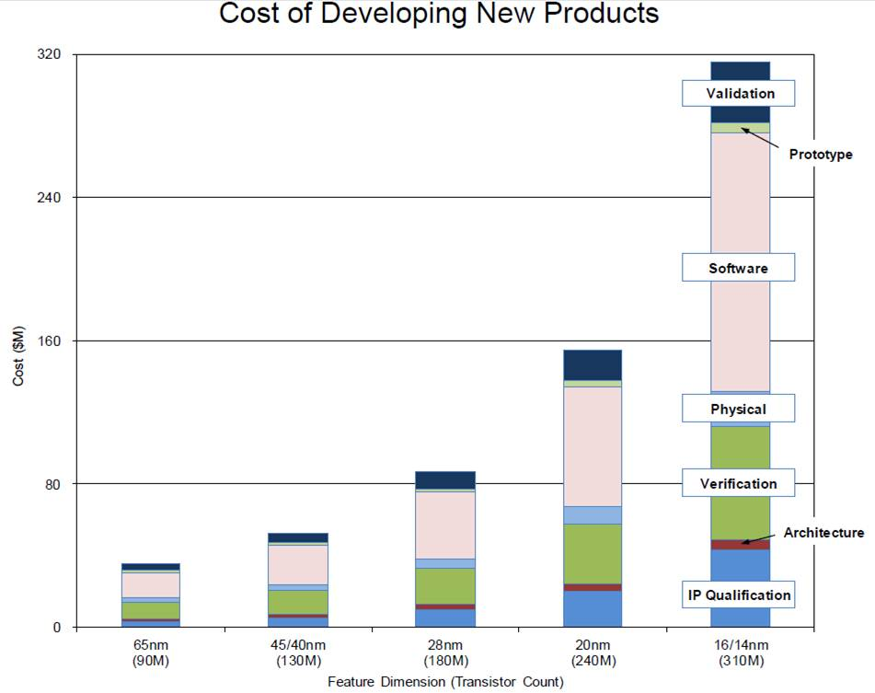
This is The Big Issue In Hardware
Source: IBS
Notes:
How does this change with Agile.

Slide 18
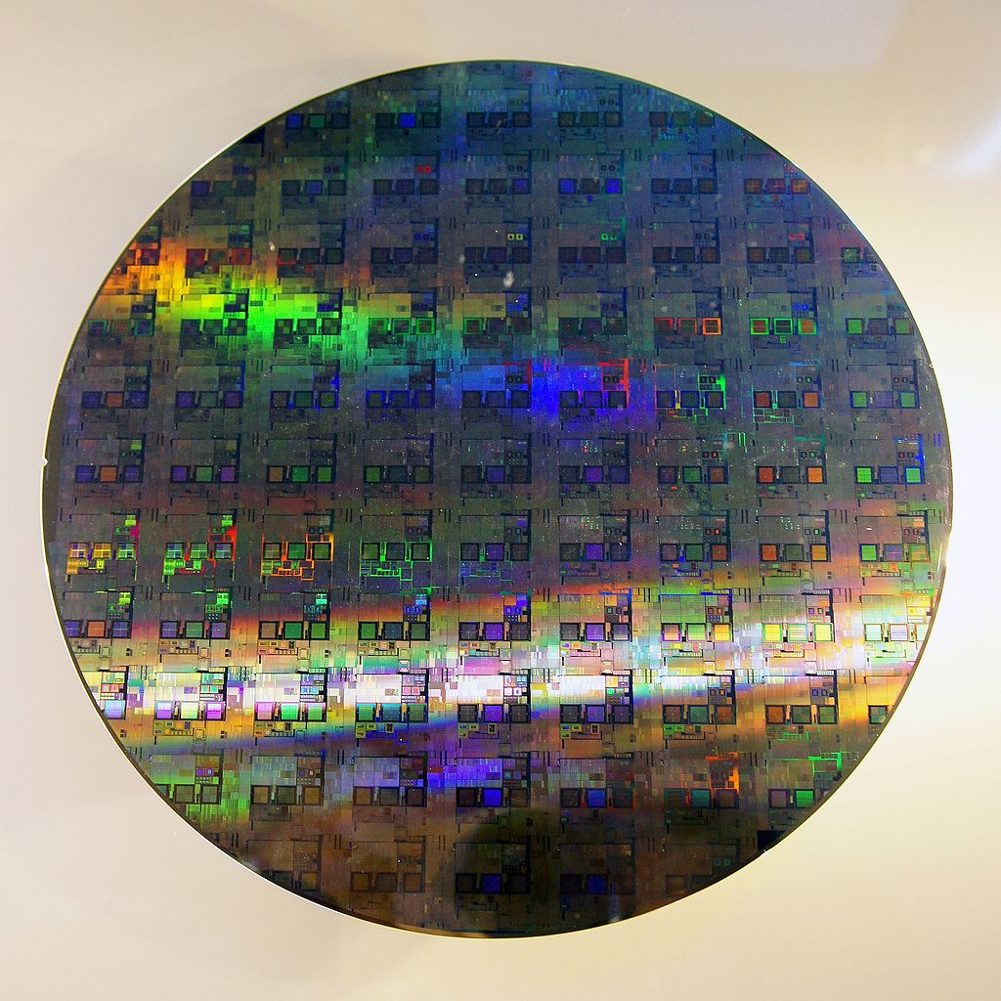
Still Need to Deal With Fabrication
https://upload.wikimedia.org/wikipedia/commons/thumb/e/eb/12-inch_silicon_wafer.jpg/1024px-12-inch_silicon_wafer.jpg

Slide 19
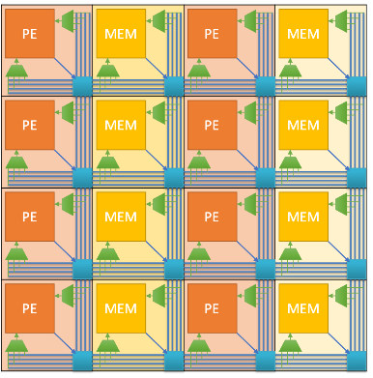
Evolve The Hardware

Slide 20
AHA Visual Computing
Create:
A new way to create DSSoCs
Use an agile design and an end-to-end flow
Create accelerators through specialization of CGRA fabric
Deliver:
Improved video analysis algorithms
A DSSoC generator for visual computing
A framework for mapping these algorithms to the DSSoC

Slide 21
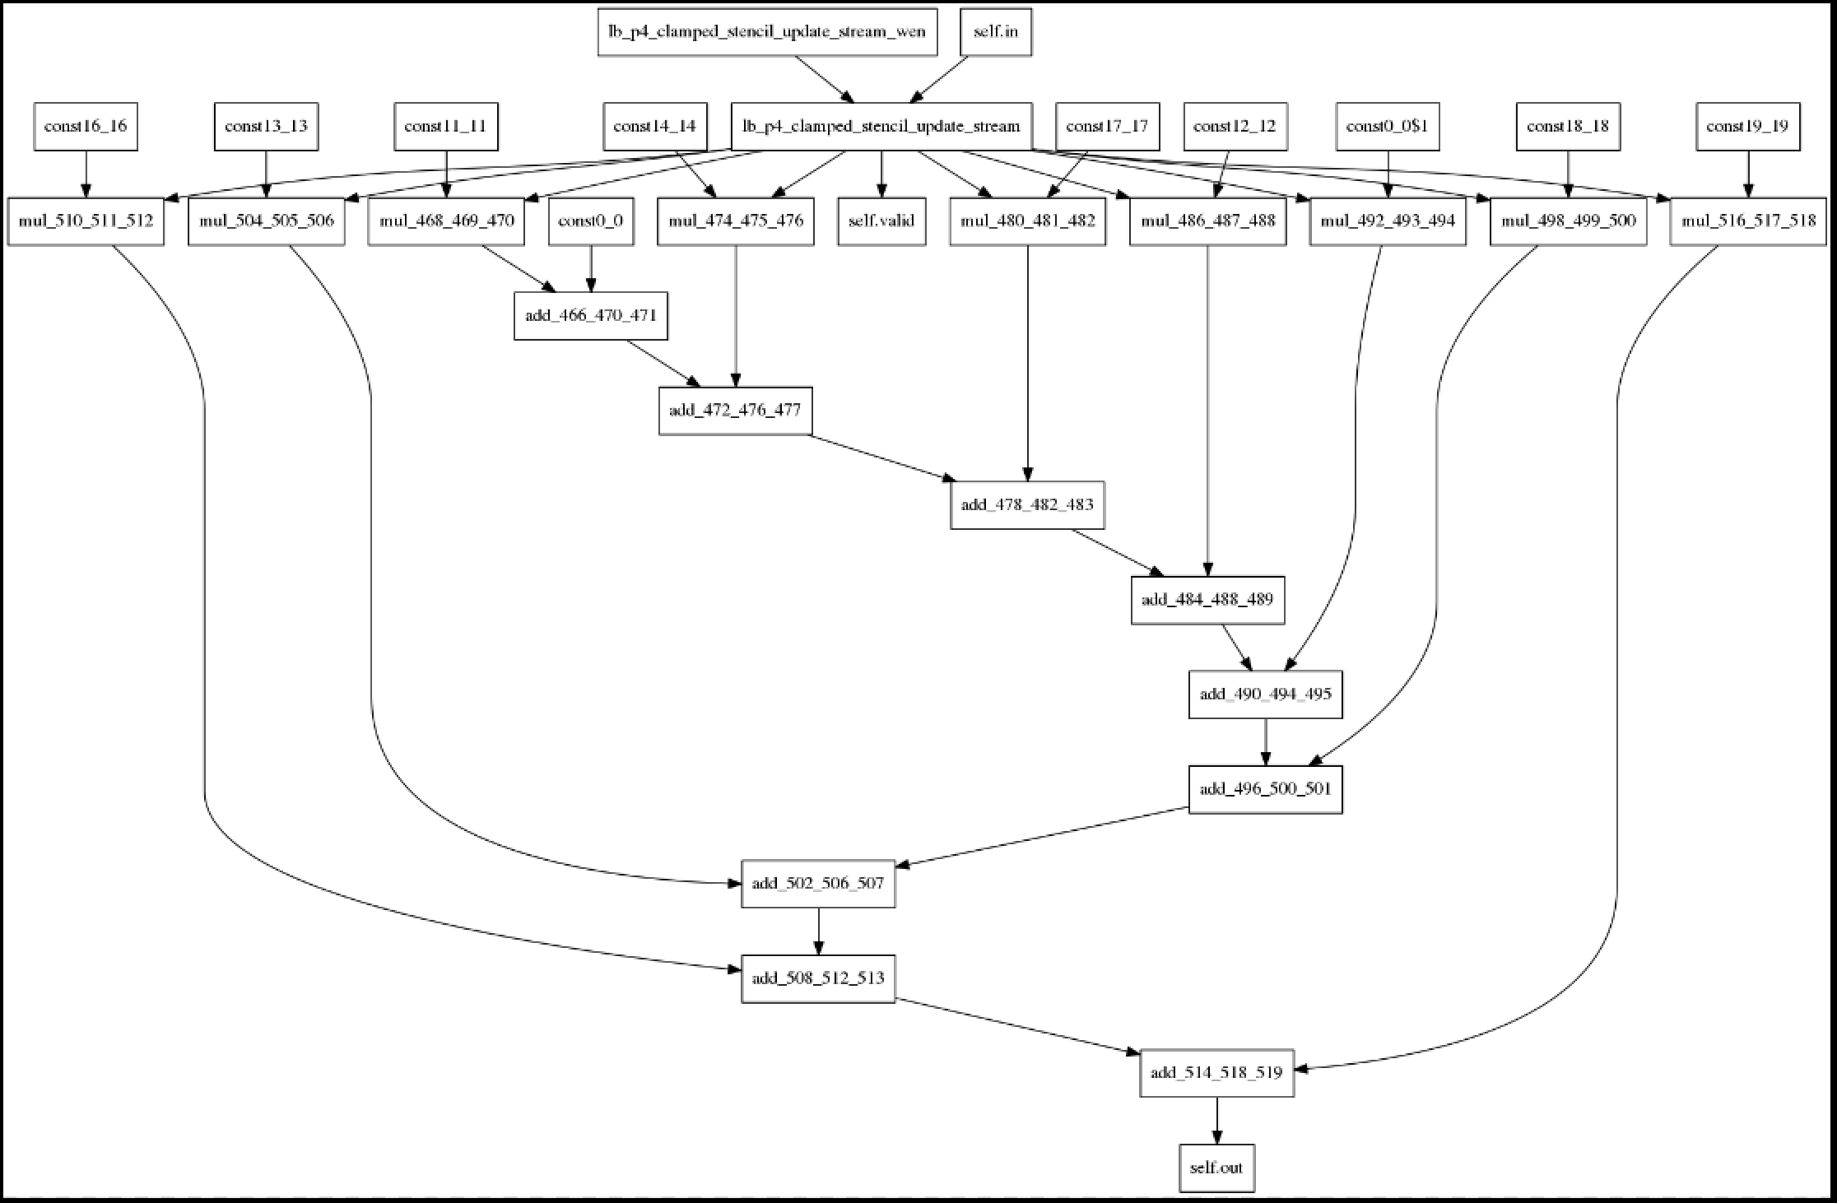
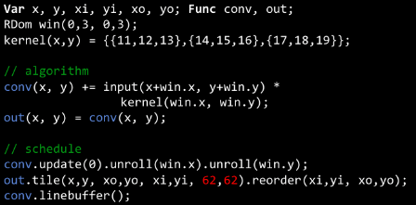
Interfaces: AHA – Visual Computing
Compiler
Halide
CoreIR

Slide 22
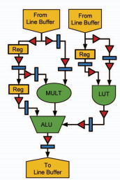
Interfaces: AHA – Visual Computing
Mapping
CoreIR
Notes:
Need better graphics – What is the points
Why am I talking about this. Make impact on industry.

Slide 23
Interfaces: AHA – Visual Computing
Place and Route
CGRA

Slide 24
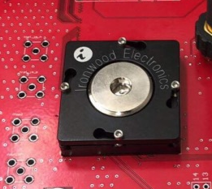
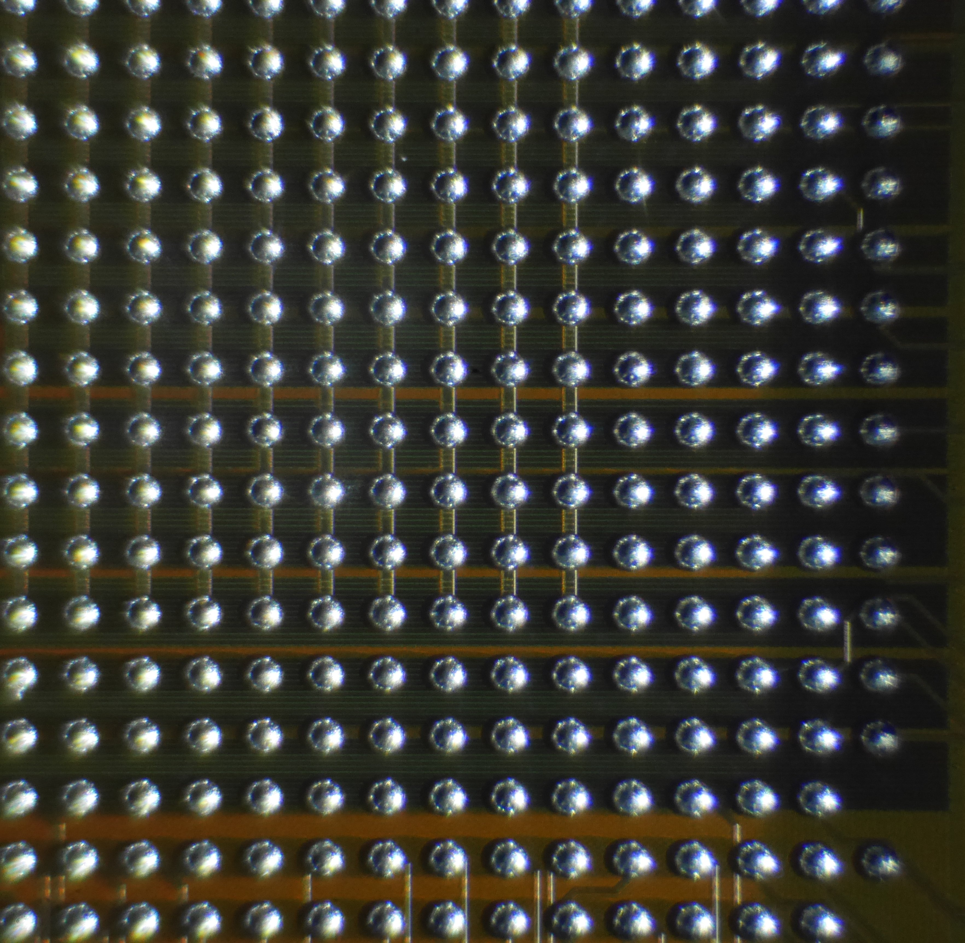
First Generation

Slide 25
Single Source of Truth

Slide 26
Created A Number Of DSL
Magma
Peak
Canal
Lake
Gemstone
Fault
Notes:
Github links

Slide 27
DSSoC Doesn’t Need to Be Expensive
One just needs to think about the problem differently
We have already created one working chip using this flow
And just taped out the next generation version

